Slide 1
Chapter
MANAGING
KNOWLEDGE FOR
THE DIGITAL
FIRM

Slide 2
KNOWLEDGE MANAGEMENT IN THE ORGANIZATION
Organizational Learning and Knowledge Management
Organizational learning
Creation of new standard operating procedures and business processes
Knowledge management
Set of processes
Creates, gathers, stores, maintains, and disseminates knowledge

Slide 3
KNOWLEDGE MANAGEMENT IN THE ORGANIZATION
Organizational Learning and Knowledge Management
Chief Knowledge Officer (CKO)
Senior executive in charge of organization’s knowledge management program

Slide 4
KNOWLEDGE MANAGEMENT IN THE ORGANIZATION
Systems and Infrastructure for Knowledge Management
Tacit Knowledge
Expertise and experience not formally documented
Best Practices
Successful solutions or problem-solving methods developed by specific organization or industry

Slide 5
KNOWLEDGE MANAGEMENT IN THE ORGANIZATION
Systems and Infrastructure for Knowledge Management
Organizational Memory
Stored learning from organization’s history
Used for decision making and other purposes

Slide 6
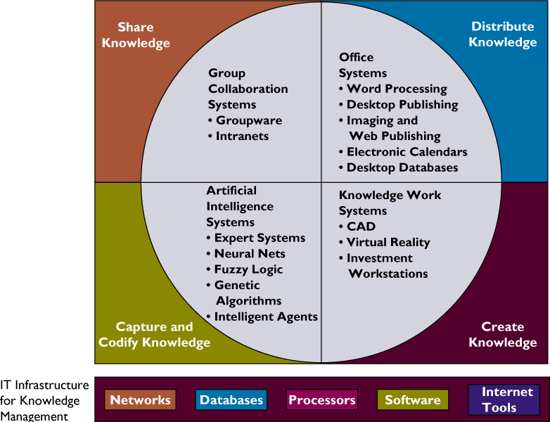
KNOWLEDGE MANAGEMENT IN THE ORGANIZATION
IT Infrastructure for Knowledge Management

Slide 7
INFORMATION AND KNOWLEDGE WORK SYSTEMS
Information Work
Consists of creating or processing information
Divided into knowledge workers and data workers

Slide 8
INFORMATION AND KNOWLEDGE WORK SYSTEMS
Distributing Knowledge: Office and Document Management Systems
Office systems
Manage and coordinate work of data and knowledge workers
Connect work of local information workers with all levels and functions of organization
Connect organization to external world
Example: Word processing, voice mail, and imaging

Slide 9
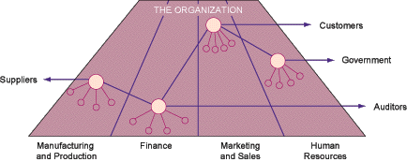
INFORMATION AND KNOWLEDGE WORK SYSTEMS
The Three Major Roles of Offices

Slide 10
INFORMATION AND KNOWLEDGE WORK SYSTEMS
Typical Office Systems
Document imaging systems
Convert documents and images into digital form
Can be stored and accessed by the computer
Jukebox
Device for storing and retrieving many optical disks

Slide 11
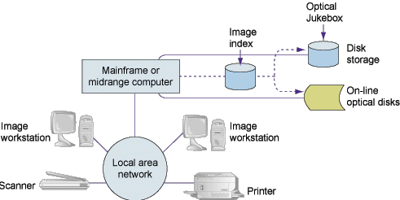
INFORMATION AND KNOWLEDGE WORK SYSTEMS
Components of an Imaging System

Slide 12
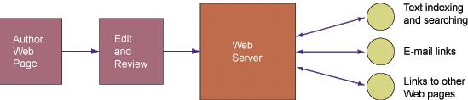
INFORMATION AND KNOWLEDGE WORK SYSTEMS
Web Publishing and Document Management

Slide 13
INFORMATION AND KNOWLEDGE WORK SYSTEMS
Creating Knowledge: Knowledge Work Systems
Knowledge Work Systems (KWS)
Information system
Aid knowledge workers in creation and integration of new knowledge

Slide 14
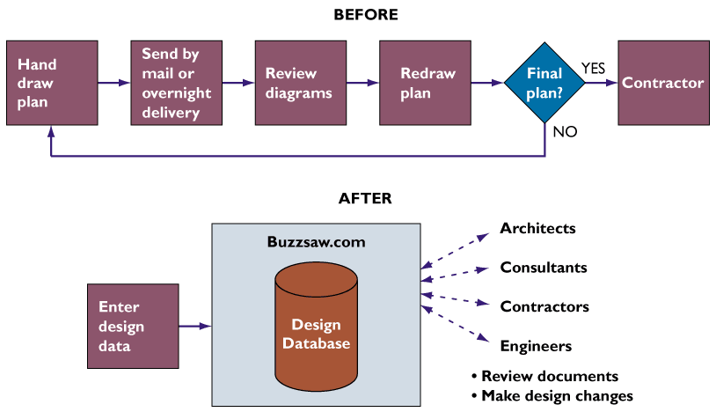
INFORMATION AND KNOWLEDGE WORK SYSTEMS
Changes in the Construction Project Management Process

Slide 15
INFORMATION AND KNOWLEDGE WORK SYSTEMS
Requirements of Knowledge Work Systems
Specialized tools
User-friendly interface

Slide 16
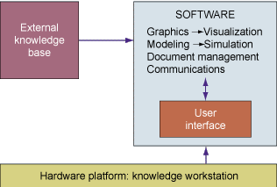
INFORMATION AND KNOWLEDGE WORK SYSTEMS
Requirements of Knowledge Work Systems

Slide 17
INFORMATION AND KNOWLEDGE WORK SYSTEMS
Examples of Knowledge Work Systems
Computer-aided design (CAD)
Virtual reality systems
Virtual Reality Modeling Language (VRML)
Investment workstations

Slide 18
INFORMATION AND KNOWLEDGE WORK SYSTEMS
Sharing Knowledge: Group Collaboration Systems and Enterprise Knowledge Environments
Groupware
Intranets and Enterprise Knowledge Environments
Enterprise information portals
Teamware

Slide 19
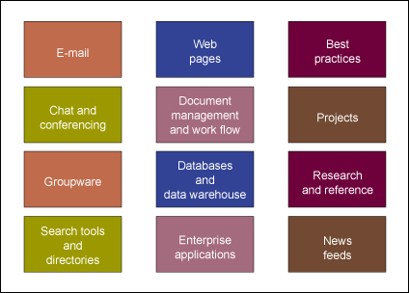
INFORMATION AND KNOWLEDGE WORK SYSTEMS
An Enterprise Information Portal

Slide 20
ARTIFICIAL INTELLIGENCE
What is Artificial Intelligence?
Effort to develop computer-based systems that behave as humans

Slide 21
ARTIFICIAL INTELLIGENCE
Why Business is Interested in Artificial Intelligence
Artificial Intelligence:
  Stores information in active form
  Creates mechanism not subjected to human feelings
  Eliminates routine and unsatisfying jobs
  Enhances organization’s knowledge base
  Generates solution to specific problems

Slide 22
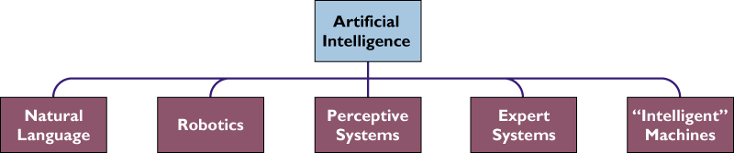
ARTIFICIAL INTELLIGENCE
The Artificial Intelligence Family

Slide 23
ARTIFICIAL INTELLIGENCE
Capturing Knowledge: Expert Systems
Knowledge Base
Rule-based Expert System
Rule Base
Knowledge Frames

Slide 24
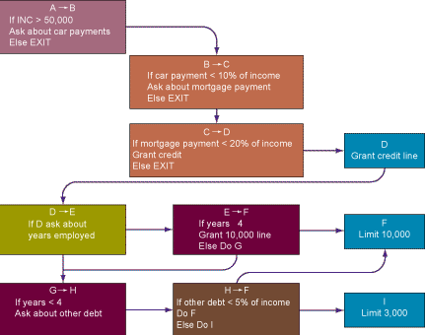
Essentials of Management Information Systems
Chapter 10 Managing Knowledge for the Digital Firm
ARTIFICIAL INTELLIGENCE
Rules in an AI Program
Figure 10-9

Slide 25
ARTIFICIAL INTELLIGENCE
Capturing Knowledge: Expert Systems
AI shell
Inference Engine
Forward Chaining
Backward Chaining

Slide 26
ARTIFICIAL INTELLIGENCE
Building an Expert System
Knowledge engineer
Specialist eliciting information and expertise from other professionals
Translates information into set of rules, or frames, for an expert system

Slide 27
ARTIFICIAL INTELLIGENCE
Organizational Intelligence: Case Based Reasoning
Case-based Reasoning (CBR)
Artificial intelligence technology
Represents knowledge as database of cases and solutions

Slide 28
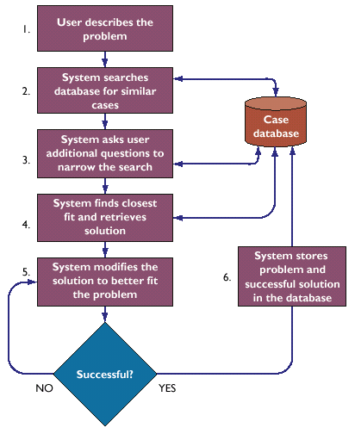
ARTIFICIAL INTELLIGENCE
How Case-Based Reasoning Works

Slide 29
OTHER INTELLIGENT TECHNIQUES
Neural Networks
Hardware or software emulating processing patterns of biological brain
Put intelligence into hardware in form of a generalized capability to learn

Slide 30
OTHER INTELLIGENT TECHNIQUES
Fuzzy Logic
Rule-based AI
Tolerates imprecision
Uses nonspecific terms called membership functions to solve problems

Slide 31
OTHER INTELLIGENT TECHNIQUES
Genetic Algorithms
Problem-solving methods
Promote evolution of solutions to specified problems
Use a model of living organisms adapting to their environment

Slide 32
OTHER INTELLIGENT TECHNIQUES
Intelligent Agents
Software programs
Use built-in or learned knowledge base to carry out specific, repetitive, and predictable tasks

